Slide 1
Introduction to Implementation Science
Geoffrey M. Curran, PhD
Director, Center for Implementation Research
Professor, Departments of Pharmacy Practice and Psychiatry
University of Arkansas for Medical Sciences
Research Health Scientist, Central Arkansas Veterans Healthcare System

Slide 2
HPV vaccine: 99+ % effective
Healthy 2020 Goal = 80%
adolescents 15 and under
US recent: 42/29%
AR recent: 34/16%

Slide 3
Naloxone
Naloxone hydrochloride (naloxone) is an opioid antagonist that reverses the potentially fatal respiratory depression caused by opioids
Stops overdose
2016: CDC recommendations
2017: Pharmacist standing orders
2018: 1 in 70 high dose prescriptions accompanied by naloxone dispensing

Slide 4
Goals for today
Discuss principles of “implementation science”
What is it? Why do we need it? When do we do it?
Discuss outcomes in implementation research
Adoption/uptake, fidelity to the intervention/practice
Summarize different strategies to promote better implementation of evidence-based practices/interventions
The interventions in this kind of work/research
E.g., education, training, prompting, incentives, mandates…

Slide 5
Some definitions…

Slide 6
Some definitions…
Dissemination: “targeted spread of information” (from the NIH program announcement for Dissemination & Implementation research)
Passive approach, focusing on knowledge transfer
Implementation: “An effort specifically designed to get best practice findings… into routine and sustained use via appropriate uptake interventions.” (Curran et al., 2012)
Active approach, focusing on stimulating behavior change
Implementation SCIENCE: “The scientific study of methods to promote the systematic uptake of research findings and other evidence-based practices into routine practice, and, hence, to improve the quality and effectiveness of health services and care.” (Eccles and Mittman, Implementation Science, 2006)
Science of how BEST to implement, create generalizable knowledge
“QI” = more local solutions

Slide 7
OK, so, some real scientific terms now…
When I teach about implementation research I often use this very simple language:
The intervention/practice/innovation is THE THING
In clinical effectiveness research, we are looking at whether THE THING works
Patients get better because of the THE THING
In implementation research, we are trying to figure out how best to help people/places DO THE THING
Implementation strategies are the stuff we do to help people/places DO THE THING
Main implementation outcomes are how much and how well the people/places DO THE THING
Curran, Implementation Science Communications, 2020

Slide 8
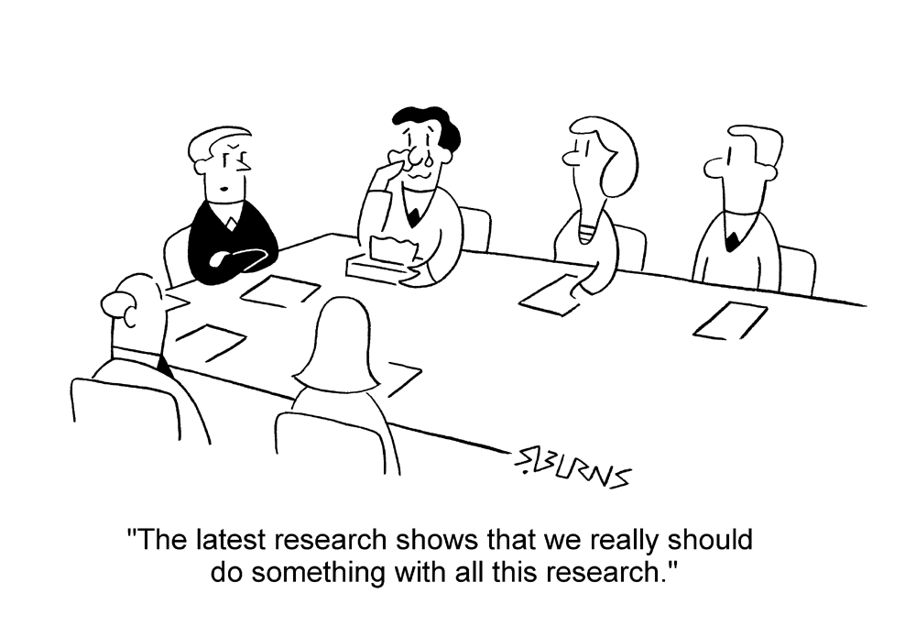
So, why do we need implementation research?

Slide 9
So, why do we need implementation research?
Only ~50% of patients in the US receive recommended/EB care
Wide variability across conditions and treatment:
79% of patients receive recommended care for an age-related cataract
11% of patients receive recommended care for alcohol use disorder
20–25% patients get care that is not needed or potentially harmful
So, we also need to DE-implement…
1.3 million people are injured annually by medication errors
Most chronic conditions have solid, evidence-based guidelines for treatment, management, and prevention, but rates of conditions such diabetes continue to rise

Slide 10
More… why we need this
17 years on average from “we know this works” to “routine delivery of it”
We have been citing this same figure for years…
Dissemination ONLY of research results, clinical practice guidelines (usually driven by research findings), etc., don’t seem to do much on their own to improve practice delivery
Except in some simpler cases…
Implementation of research findings/EBPs is a fundamental challenge for healthcare systems to optimize care, outcomes and costs

Slide 11
So, when do we do Implementation Research? (Research “Pipeline”)
Efficacy Research
Effectiveness Research
Implementation
Research
Improved processes, outcomes
Preclinical Research
NOT REALLY this linear…

Slide 12
What to measure in implementation research?

Slide 13
What are the outcomes we care about then?
We are trying to measure changes in the delivery of care
Did the place/people implement the intervention?
Did they get started? Did they start and stop?
Did everyone get it who should have gotten it?
Was the intervention/practice delivered as much as it should have been?
Were all indicated patients approached? Given intervention/practice?
Did they do it right when the were delivering the intervention?
Did they deliver the intervention as intended… with “fidelity”?
How close did they get?
Do we also look at the “effectiveness” of the intervention?
Among those who got it, did they get better?
Symptoms, functioning
If the field does not have “enough” evidence on THE THING, then yes…

Slide 14
Common Measures in Impl Research
Adoption
“Counts and amounts”
Raw count of delivery
Rates of delivery
Fidelity
“How well performed”
LOTS of different ways to measure this
Checklist; Expert rating
Sustainability
“Stick with it or dropped it?”
Adoption and Fidelity measures over time
If we are doing pilot/early work, then also look at

Slide 15
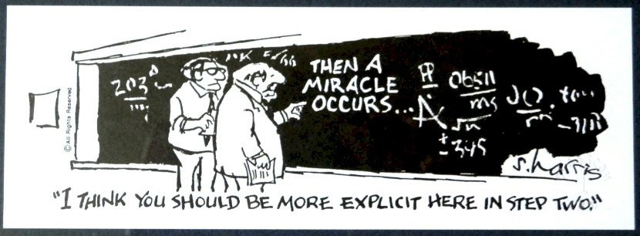
Implementation strategies

Slide 16
Implementation Strategies
Depending on the characteristics of the practice, context, and people… uptake interventions of some kind are usually necessary to support adoption– we call those implementation strategies
There are numerous types of implementation strategies available, many with research evidence supporting their use across contexts
We will now discuss a taxonomy presented by Powell et al., and Waltz et al., 2015, Implementation Science
They cover 73 strategies…
We’ll hit some highlights (only about 26!)

Slide 17
Waltz et al Taxonomy of Impl Strats
Train and educate stakeholders
Develop educational materials
Conduct educational meetings
Conduct educational outreach visits (academic detailing)
Personalized 1 on 1 sessions on intervention;
Provide ongoing consultation
In person, telephone, televideo…; usually about implementation progress
Use “train-the-trainer” strategies
More for widespread “roll-outs”; Train local trainers/mentors
Create a learning collaborative
Groupings of learners/practitioners supported by trainers/experts
Over time, experienced users teach new users (self-sustaining)

Slide 18
Waltz et al Taxonomy of Impl Strats
Provide interactive assistance
Provide clinical supervision
Expert supervision focused on the intervention/practice being adopted
Provide local technical assistance
Needed usually for medical record, dispensing software tools…
Provide facilitation
Interactive problem-solving; recommend and supply additional strategies
Support clinicians
Remind clinicians
Electronic reminders in EMR or dispensing software; or manual
“This patient due for screening…”
Revise professional roles
E.g., expand role of pharmacists
Create new clinical teams

Slide 19
Waltz et al Taxonomy of Impl Strats
Change infrastructure
Change physical structure and equipment
Need new tech? Record system? Adequate space to provide interventions to patients??
Mandate change
Create policies supportive of adoption of intervention/practice; Make people…?
Change credentialing/licensing standards
Make way for changing scope of practice, e.g., prescribing privileges to PharmDs
Utilize financial strategies
Place intervention on formulary/”covered” list
Alter incentive/allowance structure
E.g., pay for performance of practice
Penalize for not doing the intervention/practice
Make billing easier

Slide 20
Waltz et al Taxonomy of Impl Strats
Engage consumers
Prepare patients/consumers to be participants
Educate and prompt them to act; “ask your pharmacist about…”
Intervene with patients/consumers to enhance uptake/adherence
Proactively approach patients; “Let’s talk about your adherence to this medication…”
Use mass media
Spread the word… TV, posters, etc.
Develop stakeholder relationships
Identify and prepare champions
Champion = local an enthusiastic supporter of intervention; driver of change
Inform and use local opinion leaders
Recruit “influential” practitioners to support the implementation
Recruit, designate, and train for leadership
Build a coalition
Make a team that works together on the implementation

Slide 21
Waltz et al Taxonomy of Impl Strats
Adapt and tailor to context
Promote adaptability of the intervention
Adapt intervention to match local needs, but don’t sway from evidence-based-ness
Tailor implementation strategies
Tailor implementation strategies for local needs too
Use evaluative and iterative strategies
Audit and feedback
Measure and feedback performance of practitioners/sites
Conduct local needs assessment
Before you start; identify barriers/facilitators to change and target strategies
Conduct small cyclical tests of change
Iterate your change process based on data (Plan/Do/Study/Act anyone?)

Slide 22
Strategies: What do we know?
Disseminating and Training… not so great on their own
Many work “OK” (5-10% change in adoption)
Reminders, Audit & Feedback, Academic detailing, Facilitation…
No combo offers a guarantee of success
Many studies support the use of multi-component strats
But some do not!
Most multifaceted strategies involve 2 or more of these: education/training, prompts of some kind, audit and feedback
Highly regarded, only somewhat supported, is the idea that strategies work better when matched to barriers/needs identified through diagnostic analysis

Slide 23
So many questions to answer…
Why don’t the strategies we have now work better?
Which strategies work best under what conditions/contexts?
Which strategies are cost-effective (in which context…)?
How do we get EBPs to low resource counties and countries? Rural US?
How best to feasibly measure fidelity?
How much does fidelity matter to effectiveness outcomes?
De-adoption strategies?
Sustainability?
These are just a few…

Slide 24
Models, Theories, Frameworks…
Yeah, I know…

Slide 26
Determinant Frameworks
“…understand or explain influences on implementation.”
Consolidated Framework for Implementation Research (CFIR)
Characteristics of the intervention
Complexity, cost, relative advantage…
Outer setting
External policies, guidelines, incentives...
Inner Setting
Organizational culture and climate, readiness for implementation, infrastructure…
Characteristics of Individuals
Knowledge, beliefs, self-efficacy…
Process
Planning, executing, reflecting…
Used a lot to study barriers/facilitators to uptake
Used a lot to help select strategies to test

Slide 27
OK, few more frameworks, that’s it
Process models
EPIS: Exploration, Preparation, Implementation, Sustainment
Why important: Helps think about what kinds of strategies you’ll need for each “step”
Evaluation frameworks
RE-AIM: Reach, Effectiveness, Adoption, Implementation, Maintenance
Proctor framework: See above slides…
Why important: Helps answer the question, “How do I show this strategy worked or didn’t?”

Slide 28
Selected IS Resources on Campus
HMPT 6319: Implementing Change in Clinical Practice Settings
HMPT 9329: Advanced Topics in Implementation Science
IS Scholars Program
2 year program for clinician scientists
Monthly group consultations
Center for Implementation Research
4th Wednesday at 1pm

Slide 29
Question, comments, heckling…

Slide 30
Some common designs in implementation research
Remember, these designs are assuming the traditional pipeline and that it has produced “suitable” EBPs in need of implementation support
This is not always true, but we’re leave that alone today…
In this summary, I will focus on places doing the adopting
Easier to talk about places, but many studies focus on providers
I won’t provide a detailed overview of the designs, but discuss some common ones within these categories:
Within-site designs
Between-site designs

Slide 31
Within-Site Designs
We use these when we want or need to expose all places to the same thing/strategy
No comparison places; common in “QI” type scenarios or pilot tests of strategies in development (research scenarios)
VERY COMMON in Community Pharmacy Practice Research
Causal inference difficult, but many real-world uses for these data
“Post-only” design
Simplest
Can be used when we know baseline use of EBP is zippo
“Pre-Post” design
Often used when some adoption has been attempted, but it has not achieved the desired level

Slide 32
Between-Site Designs
We use these when we want to expose places to different things/strategies
Causal inference improved when places are randomized to different exposures (not always possible tho; when not, try to “balance” places on important measures)
New Strategy vs. “implementation as usual”
Key is to choose useful “implementation as usual”
Common in healthcare settings = disseminate, plus training, plus a little technical support
New Strategy 1 vs. New Strategy 2
“Comparative effectiveness trial” of 2 different strategies (or packages of them)
Different doses of same type of strategy (lo/hi intensity)? Different types?
“SMART” designs: start all with low intensity, then randomized non-responders to higher intensity strategy

