Slide 1
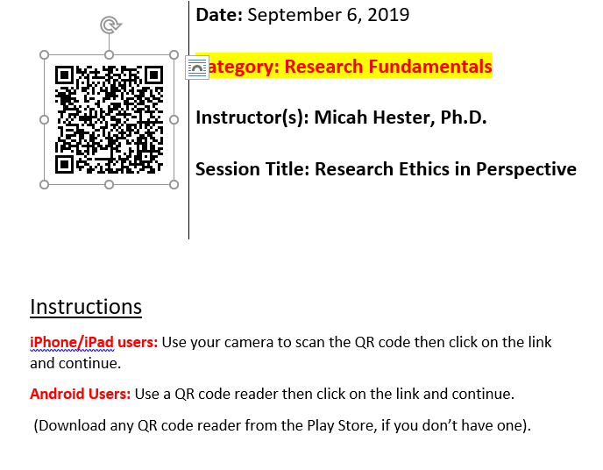
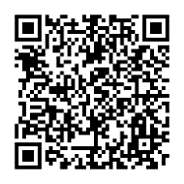
Please log your attendance

Slide 2
Research Ethics in Perspective:
Historical and Principled Context for Working with Human Participants in Research
D. Micah Hester, PhD
Chair & Prof. of Medical Humanities & Bioethics

Slide 3
What Can Go Wrong?…
[Eighteen-year-old] Jesse Gelsinger was not sick before died. He suffered from ornithine transcarbamylase (OTC) deficiency, a rare metabolic disorder, but it was controlled with a low-protein diet and drugs, 32 pills a day. He knew when he signed up for the experiment at the University of Pennsylvania that he would not benefit; the study was to test the safety of a treatment for babies with a fatal form of his disorder. Still, it offered hope, the promise that someday Jesse might be rid of the cumbersome medications and diet so restrictive that half a hot dog was a treat. ''What's the worst that can happen to me?'' he told a friend….
[From the NYT, Nov. 28, 1999]

Slide 4
…What Can Go Wrong!
[On September 17, 1999, the worst happened:] Jesse's therapy consisted of an infusion of corrective genes, encased in a dose of weakened cold virus, adenovirus, which functioned as what scientists call a vector. Vectors are like taxicabs that drive healthy DNA into cells; viruses, whose sole purpose is to get inside cells and infect them, make useful vectors. The Penn researchers had tested their vector, at the same dose Jesse got, in mice, monkeys, baboons and one human patient, and had seen expected, flu-like side effects, along with some mild liver inflammation, which disappeared on its own. When Jesse got the vector, he suffered a chain reaction that the testing had not predicted -- jaundice, a blood-clotting disorder, kidney failure, lung failure and brain death.
[From the NYT, Nov. 28, 1999]

Slide 5
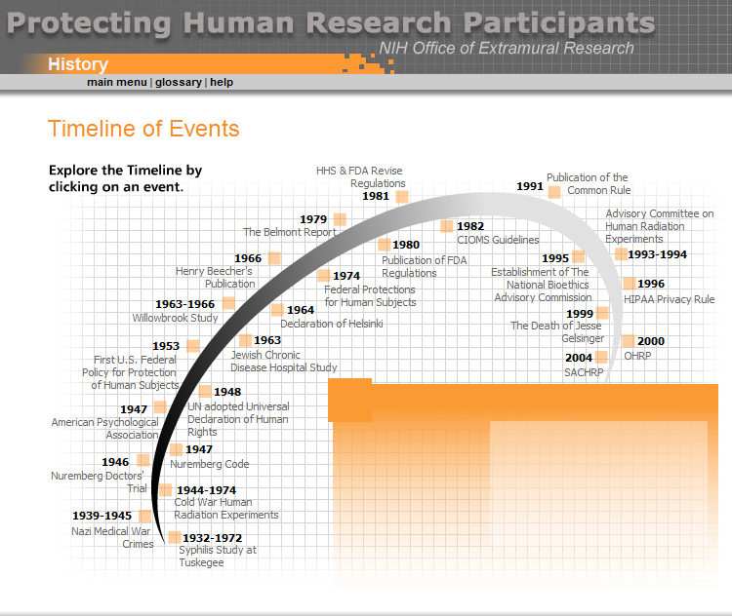
Getting Historical
20th Century Landmarks
Nuremberg Code (1947)
Declaration of Helsinki (1964;rev. 2000)
Beecher’s NEJM article, “Ethics and Clinical Research” (1966)
Tuskegee Exposed (1972)
National Commission/Belmont Report (1976-79)
DHHS Title 45, CFR 46 - The Common Rule (1991; rev. 2018)

Slide 6
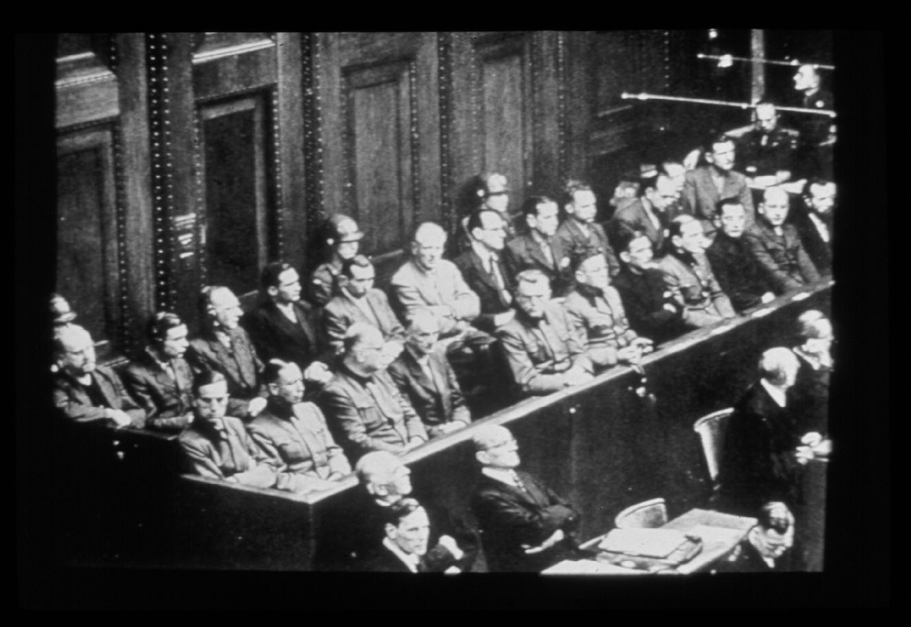
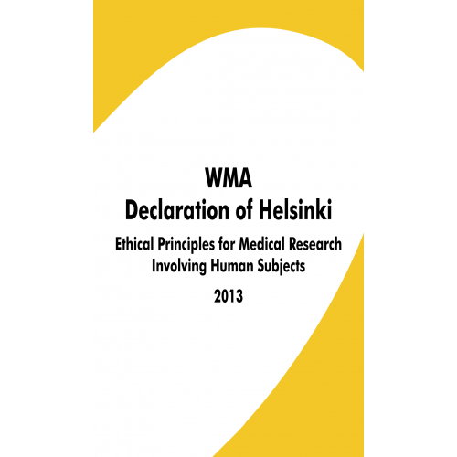
Nuremburg and Helsinki
Nuremburg Code’s 10 principles, including…
  Voluntary Consent
  Yield Fruitful Results
  Prior Animal Studies
  Risk Should Not Exceed Potential Promise
  Volunteers Can Withdraw at Any Time
Helsinki Declaration’s Protections (selected)
  Potential Benefit Must Outweigh Risks, and Risks Must Be Manageable
  Participants Must Be
    Voluntary
    Informed
    Respected (including privacy provisions)
    Can Gain Consent from a Legal Guardian

Slide 7
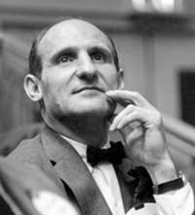
Codes Shmodes
“The Nuremberg Code was conceived in reference to Nazi atrocities and was written for the specific purpose of preventing brutal excesses from being committed or excused in the name of science. The code ... is in our opinion not necessarily pertinent to or adequate for the conduct of medical research in the United States”
Joseph Gardella, MD (1962)
Assistant Dean of Students, Harvard Medical School
Notes:
“The Nuremberg Code was conceived in reference to Nazi atrocities and was written for the specific purpose of preventing brutal excesses from being committed or excused in the name of science. The code ... is in our opinion not necessarily pertinent to or adequate for the conduct of medical research in the United States”
distinction between normal volunteers and sick patients “whose physicians foresee for them the possibility of personal benefit through their participation”
Joseph W. Gardella, M.D
Dean, Harvard School of Medicine

Slide 8
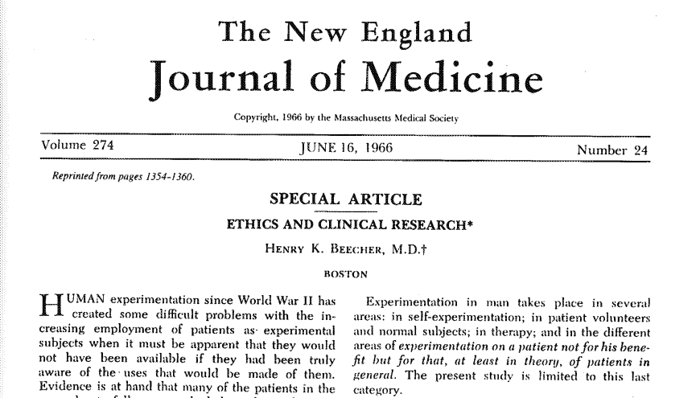
Watershed Moments:
Beecher’s Response to Gardella
“Ethics and Clinical Research” (NEJM, 1966)
  Author: Henry Beecher, MD
    Dissenting member of Gardella’s committee
  Published an annotated list of 22 ethically problematic published research trials
    Injecting cancer cells into non-consenting elderly patients
    Exposing institutionalized children to hepatitis
    No-therapy control groups in serious, treatable diseases

Slide 9
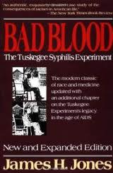
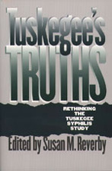
Watershed Moments:
Tuskegee Syphilis Study
Public Health Service Study, 1932-72
  Piggy-backing off a prevalence study, 1929
399 w/syphilis; 201 w/out (as control)
  African American males from Macon County, AL
Volunteered to be part of a health project
  Inducements included
    free lunch
    transportation
    health checks
    burial insurance
  Not told they had syphilis
  Subjected to tests (including lumbar punctures)
Penicillin available by late 1940s

Slide 10
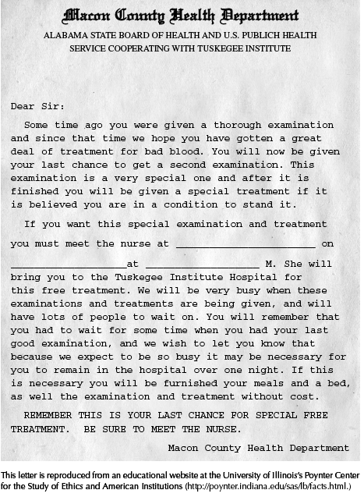
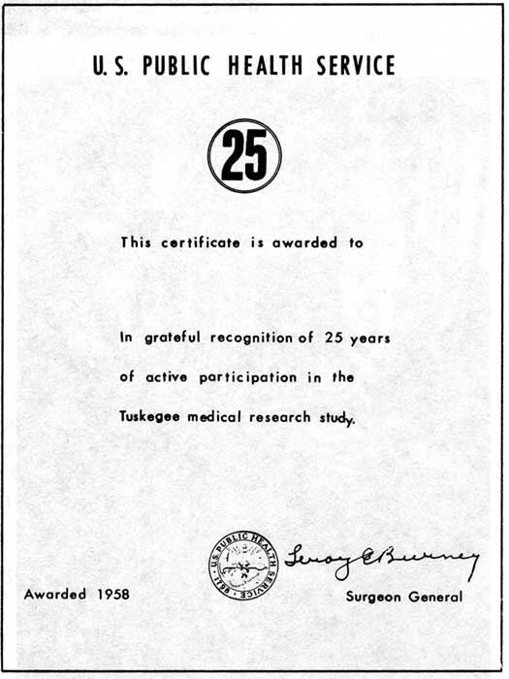

Slide 11
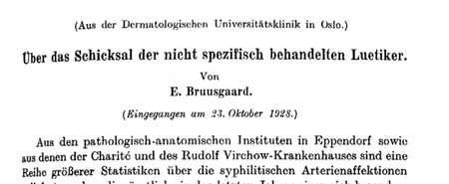
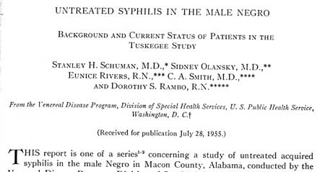
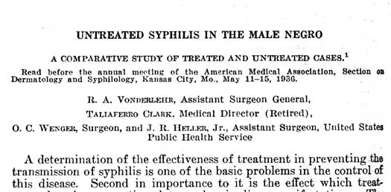
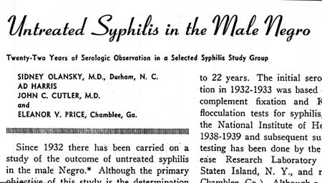
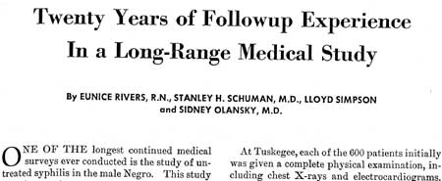
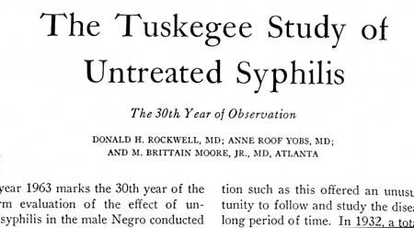

Slide 12
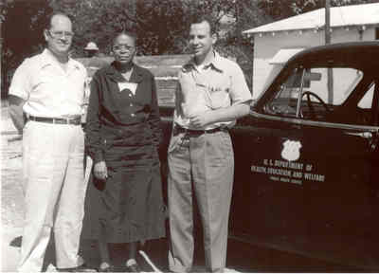
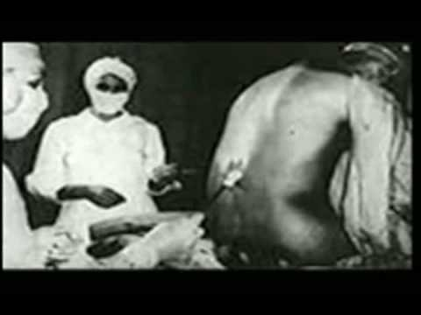
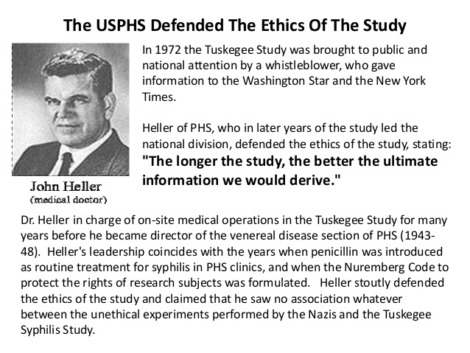

Slide 13
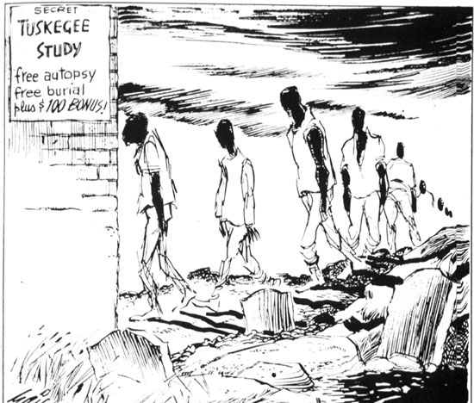
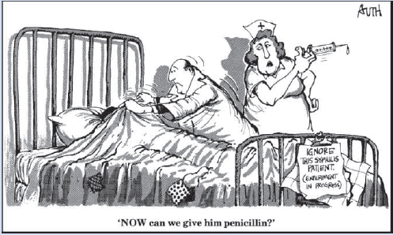

Slide 14
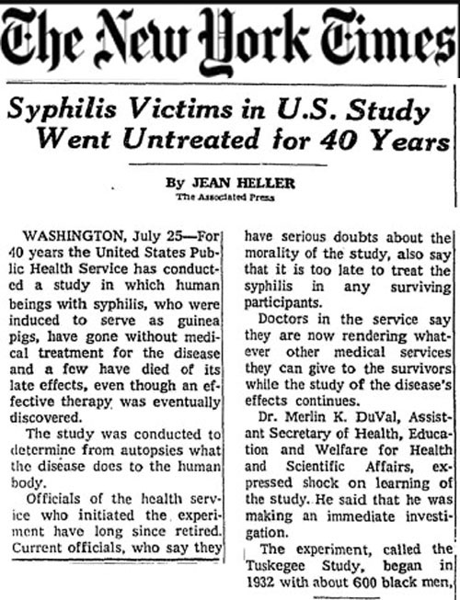
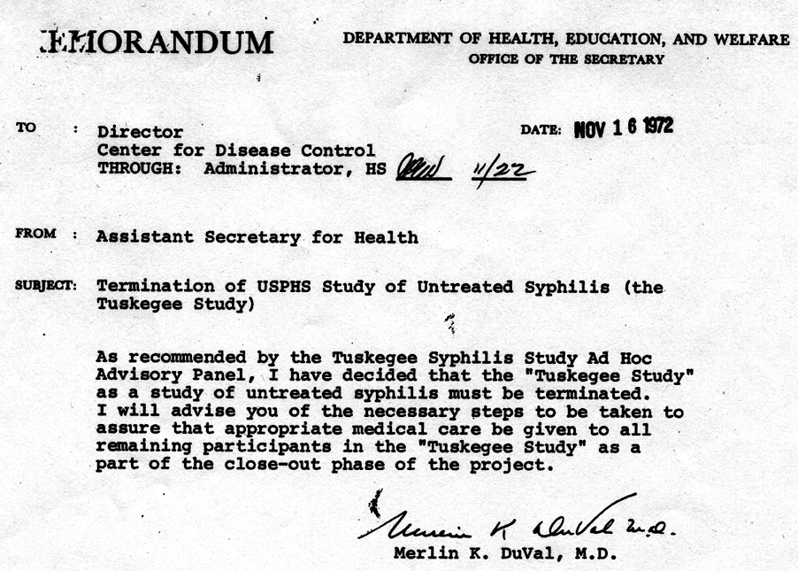
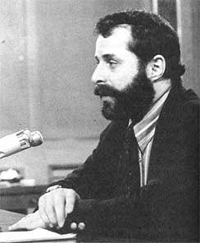
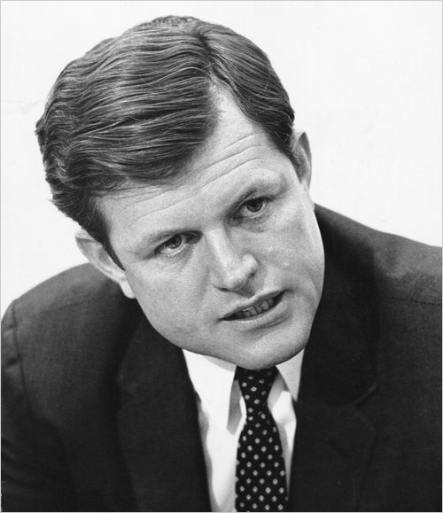

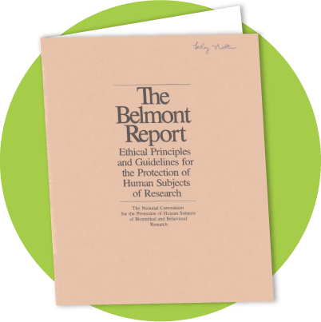

Slide 15
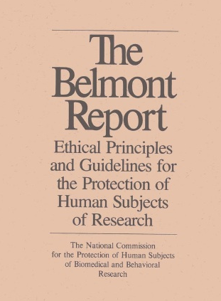
National Commission, Belmont Report (1979): Principles and Applications
Defines differences among
  Practice: “interventions that are designed solely to enhance the well-being of an individual patient…that have reasonable expectation of success”
  Experimentation: an “innovation” that “departs in a significant way from standard accepted practice”; it is “new, untested, or different”
  Research: “an activity designed to test an hypothesis, permit conclusions to be drawn, and thereby to develop or contribute to generalizable knowledge”
Identifies comprehensive “prescriptive judgments”
Principles → Applications
Respect for Persons → Informed Consent
Beneficence → Harms v. Benefits
Justice → Subject Selection

Slide 16
President’s Commission:
Protecting Human Subjects (1981)
Need for common federal regulations
Need for a DHHS office to protect human subjects in research
Need to have regular updates from PIs
Need for protection of vulnerable populations
Need for negative consequences to befall those who are guilty of misconduct

Slide 17
The Common Rule (1991; updated 2019)
45 CFR 46
Regulations for Federally Funded Human Subjects Research
  Endorsed by Most Federal Agencies
    FDA has its own human subjects regulations (21 CFR 50)
Applies to research on human subjects
  Exemptions include certain forms of educational research, “masked” video recordings, biospecimens that meet certain criteria, some research of federal program
Four Main Sections
  Human Subjects Research and IRBs (45 CFR, Subpart A - 46.1xx)
  Pregnant Women, Fetuses, Neonates (45 CFR, Subpart B - 46.2xx)
  Prisoners (45 CFR, Subpart C - 46.3xx)
  Children (45 CFR, Subpart D - 46.4xx)

Slide 18
The Common Rule:
Definitions (45 CFR 46.102)
Definitions include
  Research: “a systematic investigation, including research development, testing, and evaluation, designed to develop or contribute to generalizable knowledge.”
  Human Subject: “a living individual about whom an investigator (whether professional or student) conducting research:
    (i) Obtains information or biospecimens through intervention or interaction with the individual, and uses, studies, or analyzes the information or biospecimens; or
    (ii) Obtains, uses, studies, analyzes, or generates identifiable private information or identifiable biospecimens

Slide 19
How the History of Research Ethics Affects YOU: Federal Wide Assurance (FWA)
Human subjects research must be guided by principles
  Belmont, Declaration of Helsinki, or other approved set
Covers all research that falls under The Common Rule
  The Common Rule covers all federally funded human subjects research
Must comply with The Common Rule (and other applicable federal regulations)
  Latest revision is 2019 – know the new regulations!
Must have written procedures for reporting
  Reporting existing research as well as any misconduct
Must have adequate support for IRB efforts
  Can use external IRB, but must assure that all regulations are followed by that IRB

Slide 20
Demonstrating Respect
Must provide for adequately informed consent
Complete, uncoerced, understood
Must protect vulnerable populations
Prisoners, children, poor…
Must not use coercive advertising or compensation for participation
Payments or inducements?
Must not use exculpatory language
Cannot waive rights or deny responsibility

Slide 21
SUPPORT Trail:
Questionable Consent
Neonatal oxygenation study
Study ROP and other outcomes
Blinded, two-arms: O-sat monitoring
  O-sats kept within either 85-89% or 91-95%
  SUPPORT investigators describe both arms as being “within normal range” (85-95%) of neonatal practice/care
  (UAB consent 2004)
Investigator’s use of “standard of care” masked that what was happening to each child was constrained by a research protocol, not clinical judgment
(Hester 2013)
OHRP initial finding of “noncompliance” with regard to risk-benefit disclosure
  However, research-related risks could not be known a priori
  (OHRP letter, Mar. 7, 2013; Lantos 2013)

Slide 22
Basics of Consent
Potential participant must have decisional capacity or have a legally authorized representative
Conditions must support and protect voluntary agreement
Process, not a product
Ongoing for the duration of participation
Includes all information a reasonable person would want
Requires language understandable by the individual participant
Includes the opportunity to ask questions at any time

Slide 23
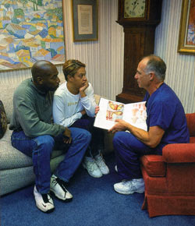
Adequate Informed Consent:
Not Just a Form
Potential Participant Must Understand, Appreciate, and Agree to
  That this is a research study
  The purpose of the study
  What specifically will be done
  Their own rights and responsibilities
  The possibility of not receiving the study drug, device, or procedure
  The risks and benefits of participating
    Neither payment nor altruism is a benefit
    Possibility or certainty of no benefit

Slide 24
Beyond Consent: Special Circumstances
Waiving Written Consent (46.117)
  Only record linking the subject and the research
  Principal risk would be potential harm resulting from a breach of confidentiality
  Each subject will be asked whether the subject wants documentation linking the subject with the research
    the subject's wishes will govern
  OR
  The research presents no more than minimal risk of harm to subjects
    Can be waived for cultural reasons as well
  Involves no procedures for which written consent is normally required outside of the research context
Waivers for Emergency Research
  The Final Rule (21 CFR, Subpart B, - 50.24)
    Community oversight and notice
Pediatric Assent
  The Common Rule (45 CFR, Subpart D - 46.408a)
  Rule of “7s”

Slide 25
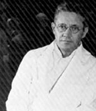
A Big Responsibility
“A far more dependable safeguard than consent is the presence of a truly responsible investigator[, practitioner, coordinator, and team members].”
–Henry Beecher, MD
But even fully responsible practitioners/investigators/teams face difficult decisions when lines are unclear or values conflict.

Slide 26
Clinical Research v.
Clinical Practice

Slide 27
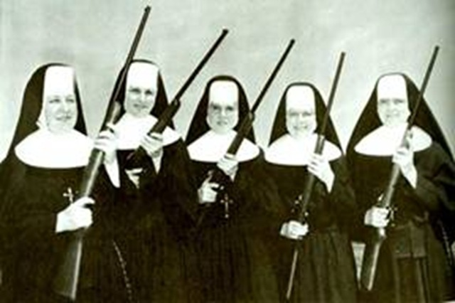
Conflicting Roles:
Clinician or Researcher?
Goals of medical care and of research are different
Roles of clinician and of investigator are different
Potential conflicts of interest arise when investigator and clinician are the same

Slide 28
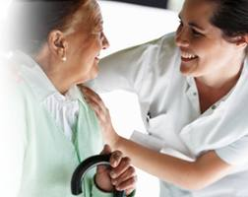
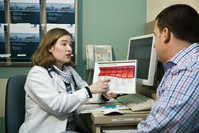



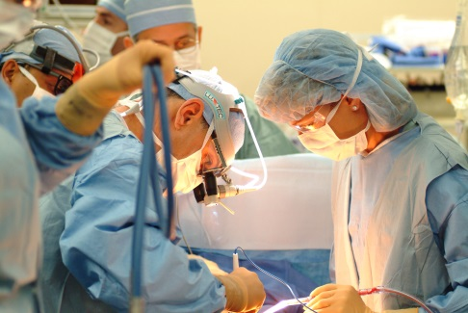
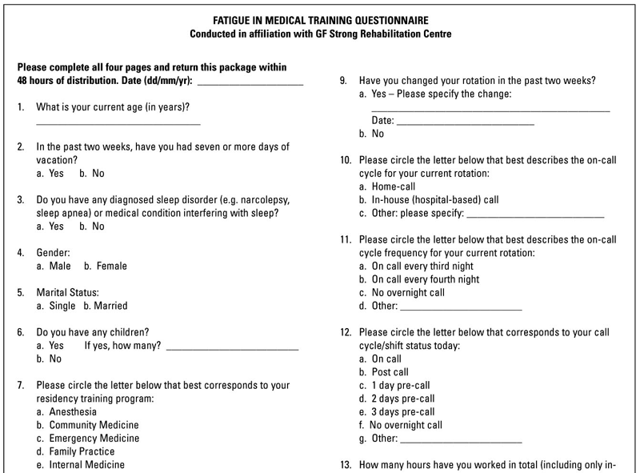
To Put It Another Way:
Patient or Participant?
Patient
Care
Research
Participation
  In other words, research is about learning how to make people better (about the interventions themselves), not about making any particular person better (though it may do so).

Slide 29
From Patient to Participant:
When Enrolling Patients is Justified
Clearly minimal risk
  Surveys, blood draws, etc.
Uncertainty Principle
  Physician uncertain whether standard therapy is any better than proposed investigational drug/device/protocol
    Judgment-based determination
Clinical Equipoise
  Medical community is uncertain about whether standard therapy (or placebo) is any better than proposed investigational drug/device/protocol
    i.e., whether there is an effective standard of care
    Evidence-based determination

Slide 30
Therapeutic Misconception:
Defining a Concern
Failure to appreciate that RCTs impose guidelines on practitioners that interfere with direct therapeutic care
(Appelbaum, et al. 1982/1987)
Belief that the purpose of a trial is to benefit the individual rather than gather data
(NBAC 2001)
Believing that research will provide therapeutic benefit
(Lidz, et al. 2004)

Slide 31
Consensus on TM?
TM = NOT understanding that research aims at generalizable knowledge
Keeping purpose/intent/aim of research clear
  Dangers
    Patients may react primarily to therapeutic intent
    Study personnel may imply therapeutic potential
      Therapeutic intent may be there (DeMarco/Markham 2004; Markham 2006)—even achievable—but should not be focus of discussion
      (Henderson, et al 2007)

Slide 32
What TM Is NOT
Therapeutic Mis-estimation
  Underestimating Risks
  and/or
  Overestimating Benefits
Therapeutic Optimism
  Hoping for best personal outcome
  (Horng & Grady 2003)
Research uses unproven methods…
  …while standard medical care (typically) uses proven methods
Research is risky…
  …but so is standard medical care
(Wendler 2012)

Slide 33
Other Factors in Communication
Psychology may interfere with reasoning
  Patients → participants register optimism and hope, not understanding (Weinfurt et al. 2008)
    Study personnel might not correct patient assumptions or inferences in order to sustain hope
  Patients → participants have unrealistic optimism (Jansen et al. 2011)
    Individuals overestimate their protections/strengths and underestimate their vulnerabilities/weaknesses

Slide 34
Prevalence of Concerning Reasons for Participation
From 30-90% of subjects exhibit therapeutic misconceptions depending on type of trial
  Findings from psychiatric, genetic, and cancer trials
  (Appelbaum, et al. 1987; 2002; 2004; Henderson et al. 2006; Daugherty, et al. 1995; Nurgat, et al. 2005)
85% of participants fail to cite research-related disadvantages/risks as risks of their participation
(Lidz, et al. 2003; 2004)
66-90% cited lack of a better option; potential for better care
  30-50% were aware that palliation w/out going into the trial was an option
65-70% because they trust their oncologist
  Misplaced trust in physician as clinician, not researcher
  (de Melo-Martin/Ho 2008)

Slide 35
Why Might Someone Want to Be a Research Participant?
To get the latest treatment available
  This is NOT a good reason to participate in research
    Remember – research does not try to help any one individual get better
To learn something about him/herself
  This is an OK reason to participate, but it may not apply
    Remember – not all research gives feedback/information to the participant
To help healthcare professionals learn about a condition or treatment
  This is a GOOD reason to participate, but be careful
    Remember – no research can promise that we learn something helpful to others

Slide 36
Coda:
The Role of the Institution
FWA and Federal Regulations – IRB & Compliance

Slide 37
IRB & More
IRB: Protecting Human Subjects/Ethical Conduct of Research
  Is this research and, if so, are human subjects involved?
  Is the research protocol flawed or scientifically pointless?
  What level of risk does it pose?
    Is that risk acceptable for a reasonable person to consider participating?
  Will subjects be adequately informed and consent obtained?
  Are the subjects to be recruited unduly vulnerable or singled-out?
  Are there adequate provisions for monitoring data?
  Have suitable protections for maintaining respect, dignity, privacy, and confidentiality been employed?
Regulatory Compliance
  Following written procedures
  Documenting specific requirements by the IRB
  Continuing review of protocols

