Slide 1
Beatrice A. Boateng, PhD
Disseminating your research through data visualization

Slide 2
Dissemination
Communicating effectively about your work
Style and format depends on audience, time allotted, venue capabilities
backup plan
Sharing your work in different formats
Journal articles
Presentations (platform, posters, elevator pitch, speed collaboration)
Notes:
Journals
Conference as presentation or poster
Department talks
Community members (recruiting to your study or sharing benefits of study)
Students
Shark Tank??
Where else?
Data visualization is depicting your data through graphs and charts

Slide 3
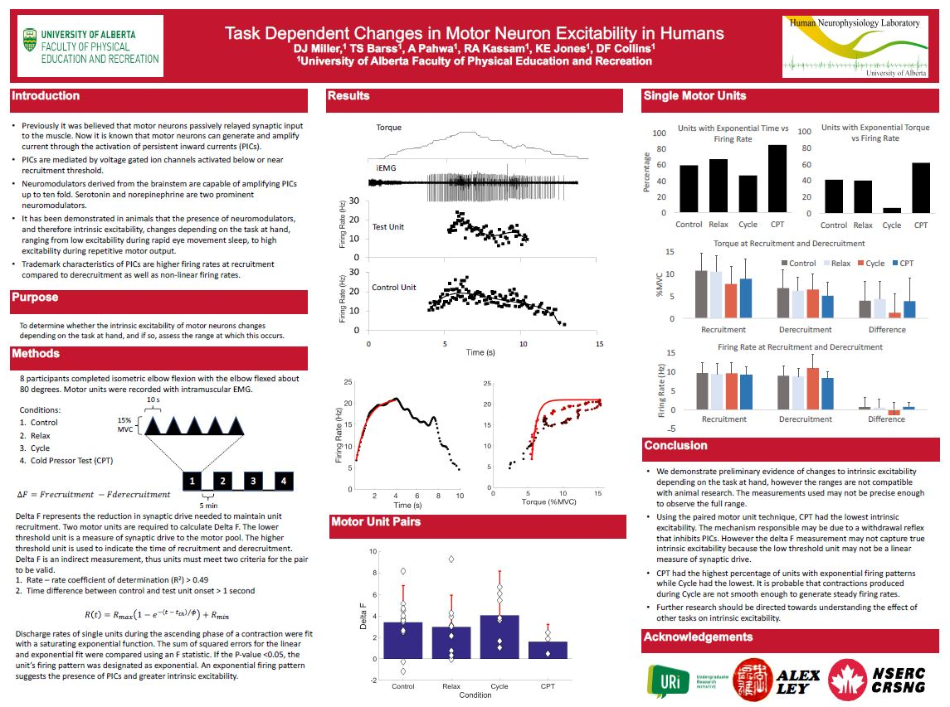
Objectives
Posters
Infographics
……..and Presentations
Notes:
Objectives
Data visualizations for posters, infographics and presentations

Slide 4
Presentation Doodle/Plan Final Product
Notes:
You have an upcoming presentation
What’s your audience
How much time
Will you include audience generated content (active learning/clickers, kahoot, etc.)
Opportunity for questions
It takes time.
Dream big
How would you like to present your data? What visual/statistic will make the maximum impact
http://annkemery.com/portfolio/dataviz-doodling/

Slide 5
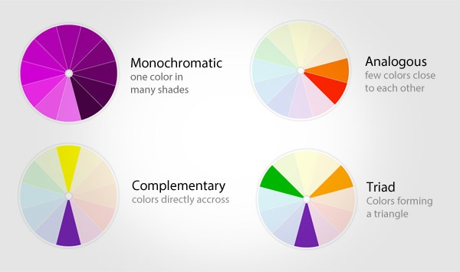
Identify your color scheme
Notes:
Often times, we are limited by institutional branding BUT you create a style sheet template with institutional colors

Slide 6
Resources for Color Scheme
Color Brewer (for Maps)
Adobe Color CC
Additional tools for color schemes
Notes:
Use rainbow ribbon for anti-bullying slogan. What do you think of when you see rainbow colors in poster/presentation, etc
The HEX number / RGB numbers tell you exactly what shade the color is
HEX number usually used for web design/web colors

Slide 7
Style Sheets
Often used in web development
Can be used for presentations / posters / infographics
Notes:
Again, we are limited about institutional color schemes
Handout

Slide 8
Presentation
Style sheet
UAMS branding guidelines
Department logos/branding
Notes:
Often times, we are limited by institutional branding BUT you create a style sheet template with institutional colors
Style sheet – what colors will you use throughout your presentation/poster
Are there templates/stylesheets available through your department. (Peds/ TRI)

Slide 9
Presentation
Tell your story
Use visually impactful images/charts/graphs
Notes:
Often times, we are limited by institutional branding BUT you create a style sheet template with institutional colors
Style sheet – what colors will you use throughout your presentation/poster
Are there templates/stylesheets available through your department. (Peds/ TRI)

Slide 10
Deciding on what to use
Quantitative Data
Qualitative Data
Notes:
It depends. Is it qualitative / quantitative data?

Slide 11
Deciding on what to use
Quantitative Data
Qualitative Data
Who is providing the Analysis / Reports?
Notes:
Some of us depend of others to provide reports / summarized data so we use whatever they provide to us
Also depends on dissemination avenue

Slide 12
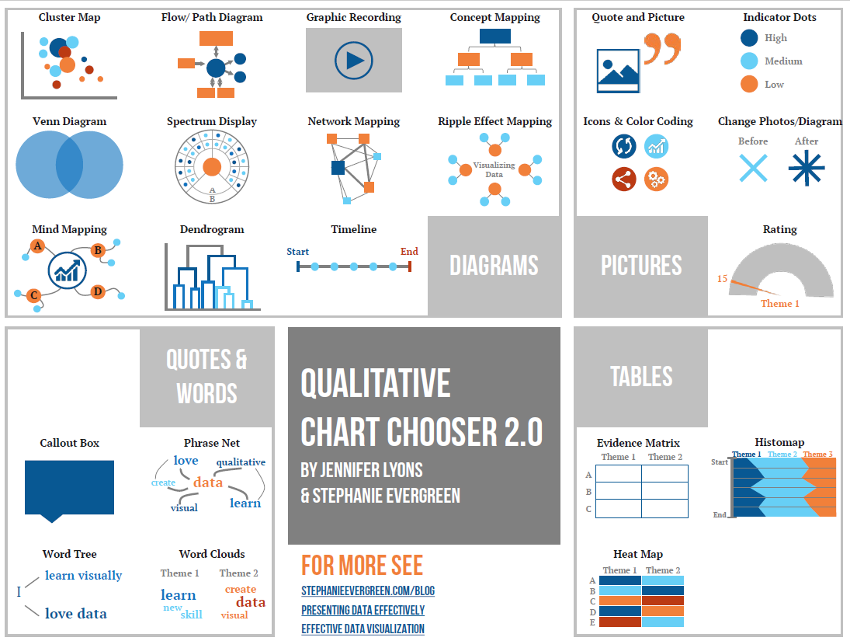
Chart chooser
Notes:
Data chooser handouts

Slide 13
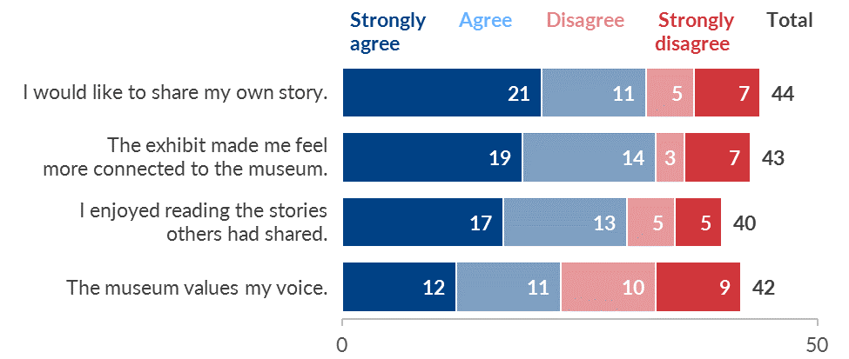
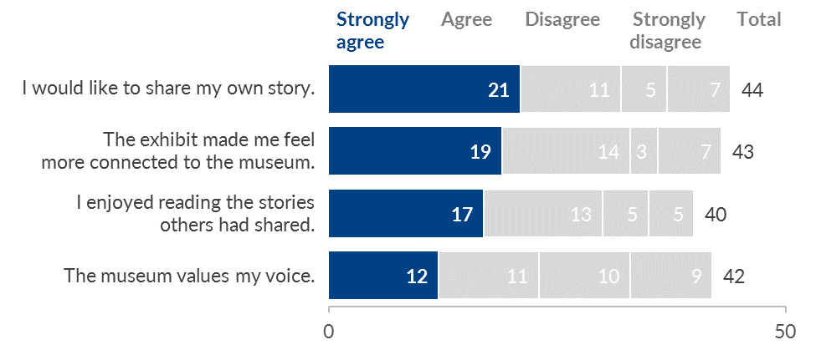
TIPS
Careful Application of color is key to directing attention
Notes:
Use rainbow ribbon for anti-bullying slogan. What do you think of when you see rainbow colors in poster/presentation, etc.
Open excel to show how to do it

Slide 14
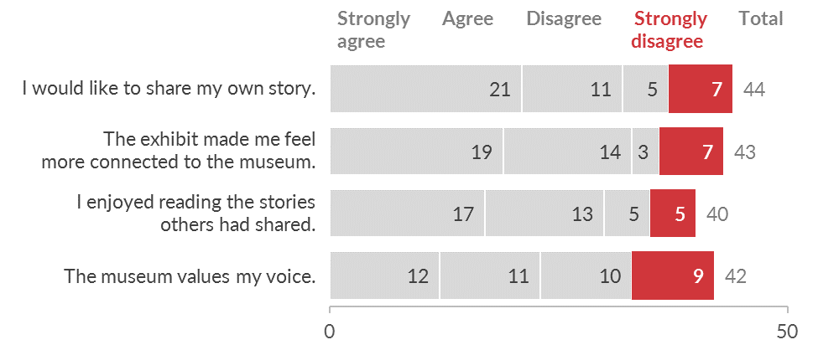
TIPS
Careful Application of color is key to directing attention
Notes:
Easy to do in Excel (show audience) how to change the colors of graphs
Use rainbow ribbon for anti-bullying slogan. What do you think of when you see rainbow colors in poster/presentation, etc

Slide 15
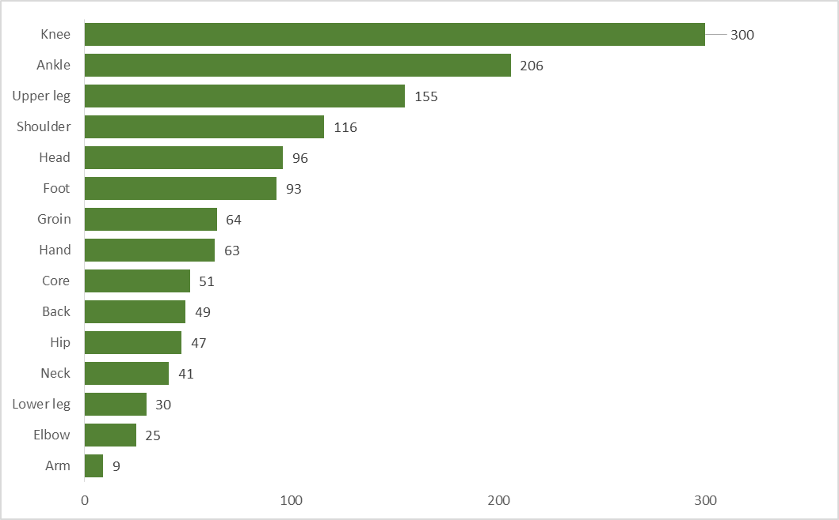
TIPS
Careful Application of color is key to directing attention
The facts about injuries in football
Notes:
Use rainbow ribbon for anti-bullying slogan. What do you think of when you see rainbow colors in poster/presentation, etc

Slide 16
TIPS
Careful Application of color is key to directing attention
The facts about injuries in football
Notes:
Use rainbow ribbon for anti-bullying slogan. What do you think of when you see rainbow colors in poster/presentation, etc

Slide 17
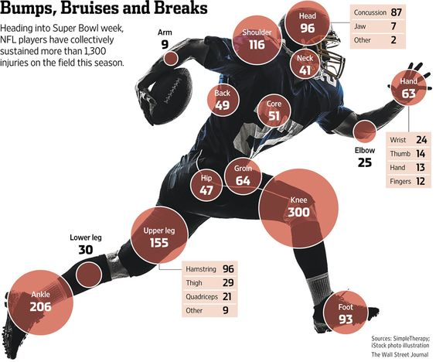
TIPS
Careful Application of color is key to directing attention
Thoughtful arrangement makes data visualization easier to interpret.
The facts about injuries in football
Notes:
Image from: https://blog.capterra.com/free-and-open-source-data-visualization-tools/

Slide 18
Graphs / charts catch a viewer’s attention
visualize the data that needs attention
Too many graphics of unimportant information dilute the power of visualization
Notes:
This slide uses color to help focus on what you should know. Use the red color to

Slide 19
Data Visualization Tools
Excel Pivot Tables
summarize large amounts of data
Dashboard
Notes:
Excel Pivot tables (on a single computer)
Maybe Microsoft 365 will allow for sharing, not sure.
Tableau is shareable

Slide 21
Data Visualization Tools
Tableau
Analytics and visualization
$$$$
Google Charts
Notes:
Excel Pivot tables (on a single computer)
Maybe Microsoft 365 will allow for sharing, not sure.
Tableau is shareable

Slide 22
Creating Posters
Identified colors
Identified appropriate charts
Notes:
Rule of 3rds

Slide 23
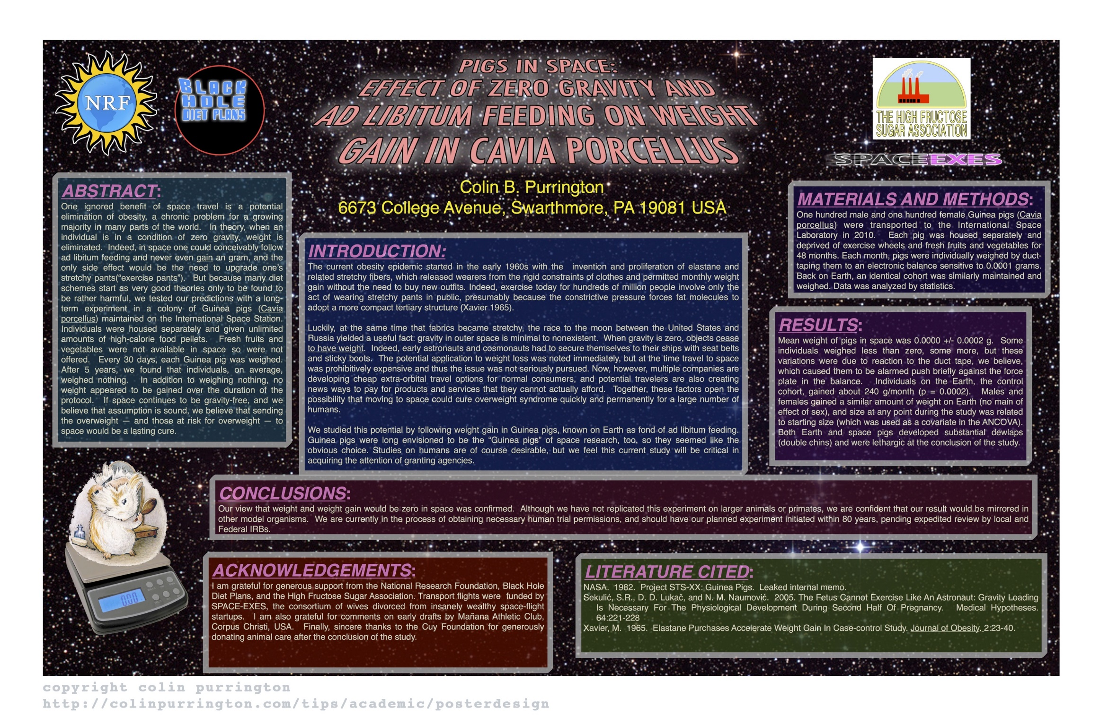
Posters
Notes:
Critique the poster. If you saw this poster at a conference, would you be attracted to it?
What do you like about it
What do you not like about it

Slide 24
Posters
Notes:
Critique the poster. If you saw this poster at a conference, would you be attracted to it?
What do you like about it
What do you not like about it

Slide 25
Notes:
Critique the poster. If you saw this poster at a conference, would you be attracted to it?
What do you like about it
What do you not like about it

Slide 26
Creating a poster
Always check posterboard requirements
Design – Slide Size – Custom Slide
Poster elements
Some text/ lots of images
Title, authors, affiliation
Grant information*
Contact information
Notes:
Create powerpoint slide
Let’s create a poster
Rule of 3rds

Slide 27
Infographics
Notes:
1 page summary
Great for
brief presentations / no powerpoint
Round table discussions
Handout

Slide 28
Infographics
Handout
Presentation
Great for elevator pitch of your research

Slide 29
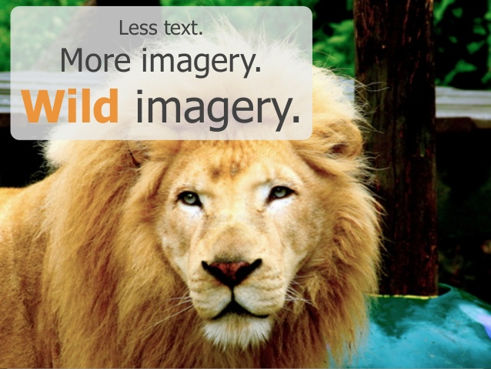
Take home points

