Slide 1
TRI Resources for Researchers
Amy Jo Jenkins, MS, CCRP, CCRC, CCRA
Jonathan Young, MA

Slide 2
What does TRI do?
TRI’s mission is to develop new knowledge and novel approaches that will measurably address the complex health challenges of rural and under-represented populations.
TRI’s vision is to be a thriving translational research ecosystem that catalyzes discoveries into health solutions for rural and under-represented populations.
TRI does not conduct research! The group’s primary objective is to facilitate translational research.

Slide 3
Sources for Identifying Research Participants – ARresearch.org

Slide 4
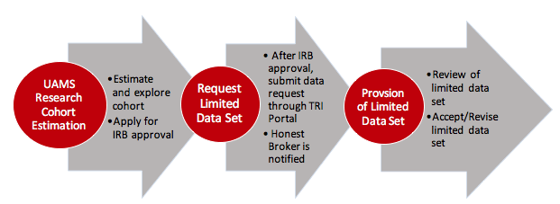
Sources for Identifying Research Participants – Arkansas Clinical Data Repository (AR-CDR)
Research data warehouse that provides a single and secure source of data for use in clinical and translational research.
Data are extracted from EPIC. Types of data include: Demographics, Admissions, Visits, Inpatient/Outpatient, Providers, Diagnoses, Immunizations, Laboratory Results, Procedures

Slide 5
Sources for Identifying Research Participants – Research Match
Free recruitment and feasibility analysis tool for researchers
Nationwide database
138 participating institutions

Slide 6
Sources for Identifying Research Participants – Arkansas Children’s Research Institute Research Registry
http://www.archildrens.org/research/resources-for-researchers/research-resources
Children and Families!

Slide 7
Sources for Identifying Research Participants – Recruitment Advertising
In partnership with Communications & Marketing, TRI can assist with:
Communications consultations
Digital communications
Developing and disseminating recruitment materials
Utilizing social media
Other support: human interest stories, your novel ideas!

Slide 8
Clinical Trials Innovation Unit (CTIU) - Location
Institute on Aging – 3rd floor
Cindy Witkowski: Director, Clinical Trials
Jonathan Young: Director, Research Administration

Slide 9
CTIU – 3 Teams
Regulatory
Research Finance
Coordinators/Research Nurses - 5 FTE plus Director; also PRN staff for expanded coverage

Slide 10
CTIU - Regulatory
Regulatory Support
Fee-based service
Work with CTIU when preparing a grant to incorporate these fees
CTIU will negotiate these fees during budget negotiations with Industry Sponsors
Assist faculty investigators. Services include:
Submissions in CLARA (new study, modifications, amendments) and reports to Sponsors and other oversight bodies
Complete startup regulatory packets from Sponsors
Report adverse events, continuing reviews and study closure
Maintenance of regulatory binders
Preparation for and completion of monitoring visits and audits

Slide 11
CTIU – Regulatory
Portal Facilitators
Free service
Review investigator initiated, human subject research protocols submitted in CLARA
Routing of submissions to appropriate regulatory committees
Assist faculty investigators with protocol development and submission

Slide 12
CTIU - Research Finance Support
Free service for investigators
(Note: may charge Industry Sponsors for certain services)
Facilitate financial startup of clinical trials utilizing clinical services
Medicare Coverage Analysis Report
Review of ICFs for financial compliance
Budget development in CLARA
Negotiate budget with Industry Sponsors

Slide 13
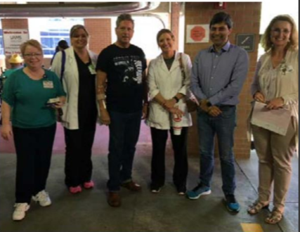
CTIU - Research Coordinator/Nurse Support
Fee-based service
Work with CTIU when preparing a grant to incorporate these fees
CTIU will negotiate these fees during budget negotiations with Industry Sponsors
Nursing Support
Research Coordinator Assistance
Participant Recruitment
Specialized Research Space & Lab Processing

Slide 14
Comprehensive Informatics Resource Center (CIRC)
Arkansas Clinical Data Repository (AR-CDR)
Profiles Research Networking Software
Comprehensive Research Informatics Suite (AR-CRIS)
REDCap
Investigator Consultations
Education and training

Slide 15
Community Engagement (CE) Consultations
Community member introductions
Partnership development
Community Review Boards
CE portions of grant applications
Identifying staff with CE expertise
Technical assistance for CE strategies

Slide 16
Other Services/Resources
Biostatistics Consultations
Mock Study Sections/Grant Reviews
Data Safety Monitoring Boards
Equipment Library
Video Library

Slide 17
Accessing Services – TRI Portal
“Request Services” buttons located throughout our website.
You may request specific resources/services.
You may also pose any research-related question. Ask anything!
Our goal is to respond within 24 hours.

Slide 18
Accessing Services – TRI Portal

Slide 19
Accessing Services – TRI Portal

Slide 20
Accessing Services – TRI Portal

Slide 21
http://tri.uams.edu/research-ebook/

Slide 22
Questions??
Please feel free to contact us!
Amy Jo Jenkins
501-686-5939
ajjenkins@uams.edu
Jonathan Young
501-526-7984
JAYoung@uams.edu

